Slide 1
Geography

Slide 2
Absolute and Relative Location

Slide 3
How do we get there?
There are two ways to answer this question. If you would like to determine a place’s location relative to someplace else, then you are looking at its Relative Location.
For example:
Our school is east of the shopping center.
Meet me at the ice cream shop next to the park.
India is located west of Bangladesh and south of Nepal.

Slide 4
How do we get there?
Another way to answer this question is by giving an Absolute Location. An absolute location is the specific coordinates of a place on earth.
For example:
Vancouver, British Columbia is located at 50 degrees North and 127 degrees West.

Slide 5
Relative Location
For now, we are going to focus on Relative Location. Specifically, we would like to be able to refer to places on a map in terms of where they are located relative to other places using cardinal and intermediate directions.

Slide 6
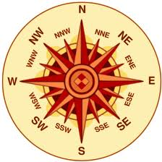
Cardinal Directions Intermediate Directions
North
South
East
West
Northeast
Northwest
Southeast
Southwest

Slide 7
As a team, use an atlas to answer to the following:
Tennessee is _______________ of Kentucky.
Georgia is _______________ of Florida.
Ohio is ______________ of Pennsylvania.
Colorado is ______________ of Utah.
Oregon is _______________ of California.

Slide 8
Independently, use a map to write three sentences using cardinal directions and three sentences using intermediate directions. You may use countries, states, cities or physical features.
Example:
Bolivia is northeast of Chile.

