Slide 1
The Three Branches of Government

Slide 2
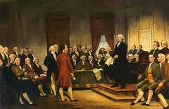
The Three Branches of Government
The Founding Fathers, the framers of the Constitution, wanted to form a government that did not allow one person to have too much authority or control. While under the rule of the British king they learned that this could be a bad system. Yet government under the
Articles of Confederation
taught them that there was
a need for a strong
centralized government.

Slide 3
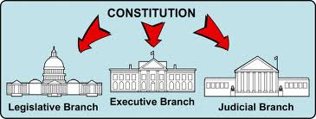
The Three Branches of Government
With this in mind the framers wrote the Constitution to
provide for a separation of powers, or three separate
branches of government.

Slide 4
The Three Branches of Government
Each has its own responsibilities and at the same
time they work together to make the country run
smoothly and to assure that the rights of citizens are
not ignored or disallowed.

Slide 5
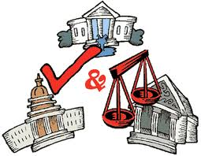
Checks and Balances
This is done through
checks and balances.
A branch may use its
powers to check the
powers of the other
two in order to maintain
a balance of power
among the three
branches of government.

Slide 6
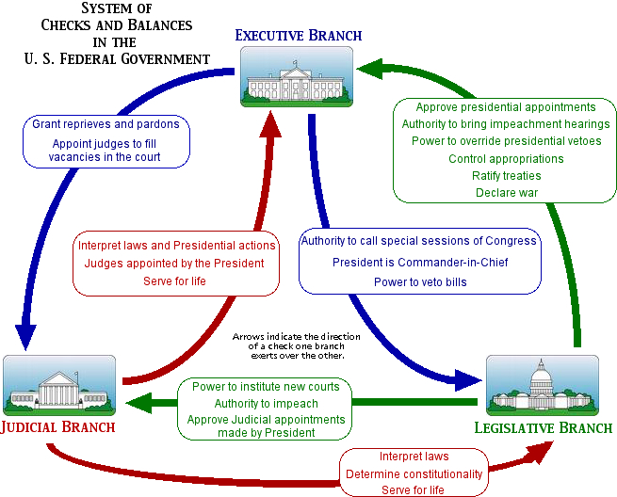

Slide 7
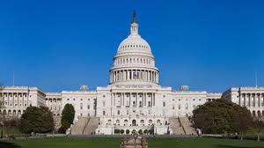
Legislative Branch
The legislative branch of government is made up of
the Congress and government agencies, such as the
Government Printing Office and Library of Congress,
that provide assistance to and support services for
the Congress. Article I of the Constitution established
this branch and gave
Congress the power
to make laws.
Congress has two
parts, the House of
Representatives and
the Senate.

Slide 8
Legislative Branch
Legislative Branch
Federal Level
State Level
Local Level
Congress
Senate Assembly
City Council
and
Town Boards
Senate
House of Representatives

Slide 9
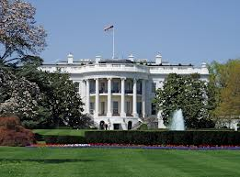
Executive Branch
The executive branch of
Government makes sure
that the laws of the United
States are obeyed. The
President of the United
States is the head of the
executive branch of
government. This branch is very large so the
President gets help from the Vice President,
department heads (Cabinet members),and heads of
independent agencies.

Slide 10
Executive Branch
Executive Branch
Federal Level
State Level
Local Level
President
Vice President
Cabinet
Governor
Lieutenant Governor
Mayor
Town Supervisors

Slide 11
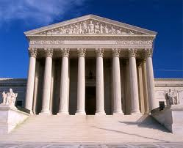
Judicial Branch
The judicial branch of government is made up of the
court system. The Supreme Court is the highest court
in the land. Article III of the Constitution established
this Court and all other Federal courts were created
by Congress. Courts decide
arguments about the
meaning of laws, how they
are applied, and whether
they break the rules of the
Constitution.

